Slide 1
Movie recommendation system
Maaz Saad

Slide 2
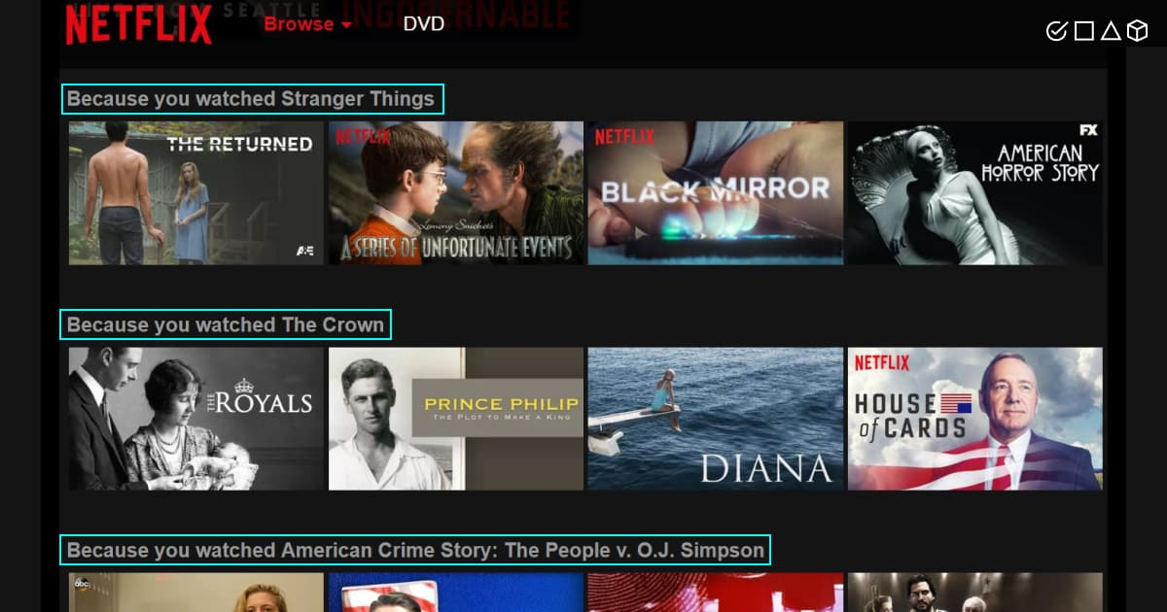
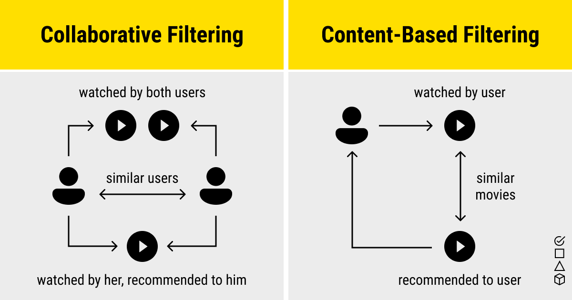


Project Overview

Slide 3
Walkthrough of the movie recommendation system

Slide 4
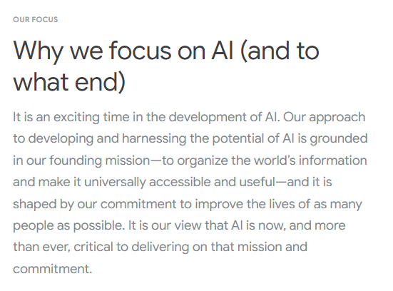
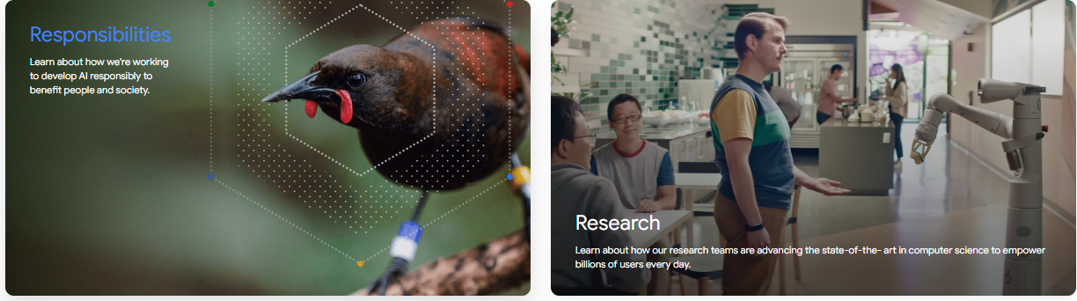
Ethical considerations

Slide 5
Conclusion

Slide 6
THANK YOU

